Slide 1

SortingEnv: An Extendable RL-Environment for an Industrial Sorting Process
Milestone 2 by Bruno Garofalo and Kerim Sever

Slide 2
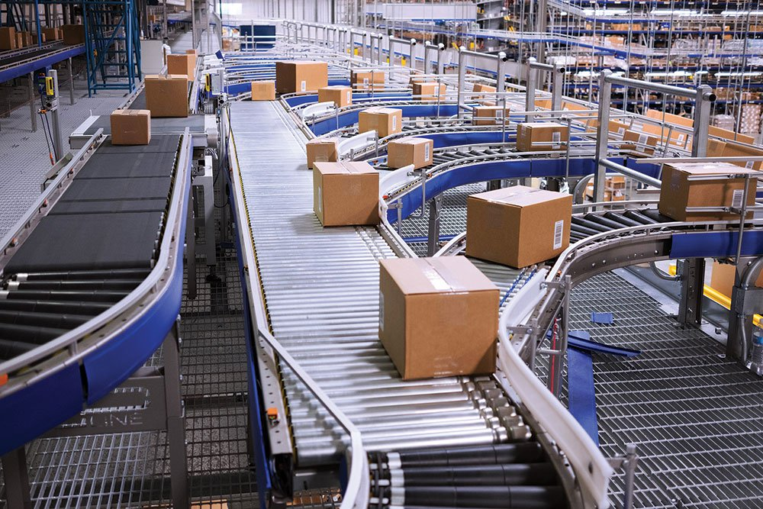
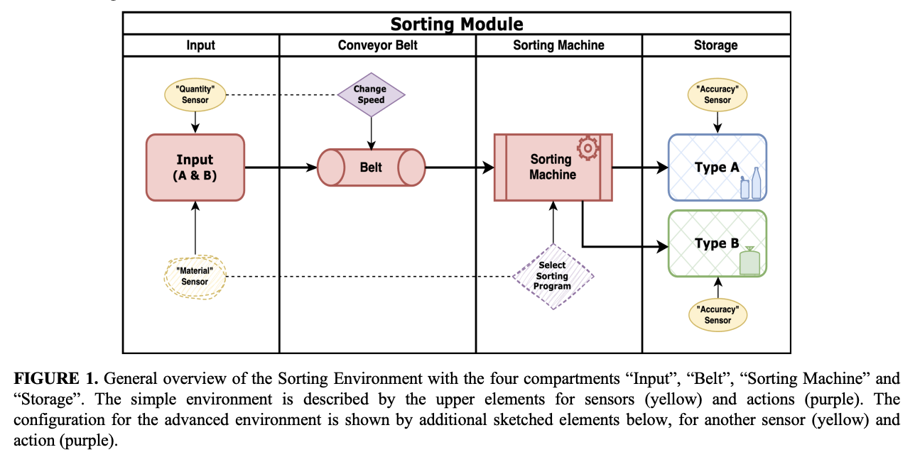
The scenario
Complex industrial system using Reinforcement Learning (RL) to optimize material sorting performance based on:
Belt speed
Material occupancy
Sorting accuracy
Paper link: 2503.10466
Authors: Tom Maus, Nico Zengeler, Tobias Glasmachers
Github: SortEnv

Slide 3
Model Stages
Input stage: random mix of material A and B
I_{total} = I_{A} + I_{B}
Input generation mechanisms for simulating the sorting environment:
Random input generator: produces input quantities within a predefined range (e.g. 5% - 95%)
Seasonal pattern generator: selects an input pattern (e.g. 10-30%, 40-60%, 70-90%) and a corresponding length (e.g. 10-12 timesteps) from a predefined range
Belt stage: the materials are transferred to the conveyor belt, and belt occupancy is calculated.
O_{belt} = (B_{A} + B_{B})/100
B_{A} and B_{B} represent the material quantities on the belt
Notes:
Random generator: , ensures variability without a discernible pattern. This method is effective in testing the robustness of the sorting system under unpredictable conditions.
Seasonal pattern generator: selects an input pattern (e.g. 10-30%, 40-60%, 70-90%) and a corresponding length (e.g. 10-12 timesteps) from a predefined range. It then maintains this pattern for the duration of its length before selecting a new pattern and length.
Input phases: "Little Input," "Medium Input," and "Much 6 Input", come with varying ratios of materials A and B, introducing structured periodic changes in the input flow

Slide 4
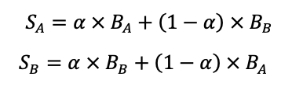
Model Stages
Sorting Stage:
S_{A} and S_{B} represent the quantity of material A and B correctly sorted out
⍺ represents the proportion of correctly sorted material A and B

Slide 5


Markov Decision Process Formulation - Base Environment
(MDP) = (S,A,P,R,γ)
States representation (S):
Represents the total amount of material on the input belt
Normalized to be between 0 and 1
I_{total_norm} = (I_{A} + I_{B})/ max belt capacity
Actions representation (A):
Ten discrete actions corresponding to belt speeds of 10% to 100%.
a ∈ {0.1, 0.2, 0.3, 0.4, 0.5, 0.6, 0.7, 0.8, 0.9, 1.0}

Slide 6
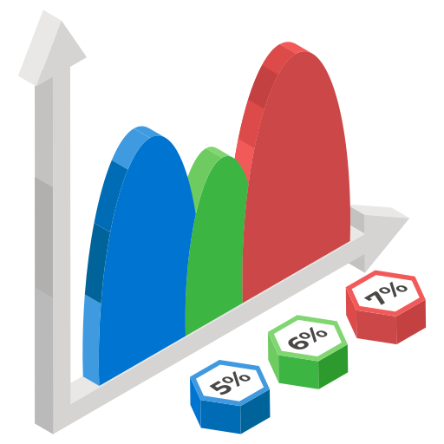
Markov Decision Process Formulation - Base Environment
Transition probabilities (P):
The random noise added to the system makes the transitions stochastic
P(s_{t+1​}∣s_{t}​,a_{t​})=f(s_{t​},a_{t​},noise)

Slide 7

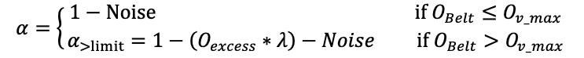
Markov Decision Process Formulation - Base Environment
Reward function (R):
The agent must dynamically adjust and find the optimal speed in each setup
The reward is calculated based on the accuracy for the material currently on the belt, and the belt speed v
All values below a minimum accuracy threshold (0.7) will return a negative reward of -0.1 immediately
A weight for the importance of both components can be set with the reward factors r_{acc} and r_{speed}
The penalty can be applied to limit the total number of speed changes in input-setups that are not fully random
⍺ represents the sorting accuracy
O_{v_max} is the maximum belt occupancy limit per belt speed
λ is the accuracy abatement rate
Noise factor introduced to account for variability
Notes:
The penalty can be applied to limit the total number of speed changes in input-setups that are not fully random, e.g. the seasonal input to enhance the realism of the simulation by encouraging the agent to maintain consistent speeds

Slide 8
Markov Decision Process Formulation - Advanced Environment
Premise:
The basic environment allows only for discrete belt speed adjustments
Advanced environment simulated a machine upgrade by introducing three sorting modes:
Notes:
Advanced env introduced to simulate a machine upgrade by introducing three sorting modes: basic sorting, positive sorting, and negative sorting.
This approach, adds a layer of realism and strategic depth
When the correct sorting mode is selected, the machine may internally adjust frequencies or other operational parameters to enhance sorting precision and reduce noise

Slide 9
Markov Decision Process Formulation - Advanced Environment
Actions representation:
Action space expanded to include a total of 30 actions: ten discrete actions corresponding to belt speeds of 10% to 100% x 3 sorting modes
A ∈ {(0.1, B), (0.1, P), (0.1, N), (0.2, B), (0.2, P), (0.2, N),....., (1.0, B), (1.0, P), (1.0, N)}
States representation:
Total amount of material on the input belt
Ratio of material A to material B
I_{total_norm} = (B_{A} + B_{B})/ max belt capacity
M_{ratio} = B_{A}/B_{B}

Slide 10
Markov Decision Process Formulation - Advanced Environment
Transition probabilities:
The random noise added to the system makes the transitions stochastic
P(s_{t+1​}∣s_{t}​,a_{t​})=f(s_{t​},a_{t​},noise)

Slide 11


Markov Decision Process Formulation - Advanced Environment
Reward function:
The reward function remains the same
Sorting accuracy in the advanced environment is influenced by belt speed, occupancy, and the selected sorting mode
Noise levels vary based on the sorting mode, and incorrect mode selection incurs an indirect penalty by reducing accuracy
Notes:
The reward function remains the same, indirectly considering the chosen sorting mode as it influences the current accuracy
For example, knowing the ratio of incoming materials allows the machine to optimize its sorting mechanism, increasing accuracy by 15% and decreasing noise to a range of 0 to 5%. Conversely, selecting an incorrect sorting mode can degrade performance, reducing accuracy by 10%

Slide 12
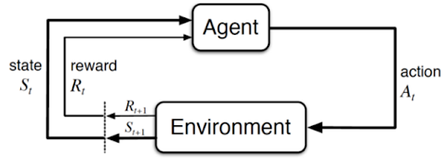
MDP formulation
Why this MDP?
Sequential Decision Making
Stochastic and Dynamic Nature of the Environment
Adaptability and Complexity
Notes:
Sequential Decision Making: The process of optimizing a sorting system involves making decisions at different time steps based on the current state of the system. The agent must adjust the belt speed, which impacts the efficiency of sorting materials. These decisions are sequential, meaning the outcome of one action affects subsequent states and actions, which aligns with the core structure of an MDP, where the future state depends on both the current state and the action taken.
Stochastic and Dynamic Nature of the Environment: The industrial sorting environment is dynamic, with frequent changes in process variables like belt speed, material flow and it involves some level of randomness or uncertainty, The MDP framework can handle such stochasticity effectively by incorporating transition probabilities that account for the uncertainty in how actions will influence the next state.
Adaptability and Complexity: The environment is designed to scale in complexity, from a basic setup with discrete actions (belt speed adjustments) to an advanced one with multiple sorting modes and more detailed observations. MDPs are flexible enough to model both simple and complex environments, adapting to changes in the state and action spaces. This makes MDPs an ideal framework for modeling both the basic and advanced v ersions of the sorting system.

Slide 13
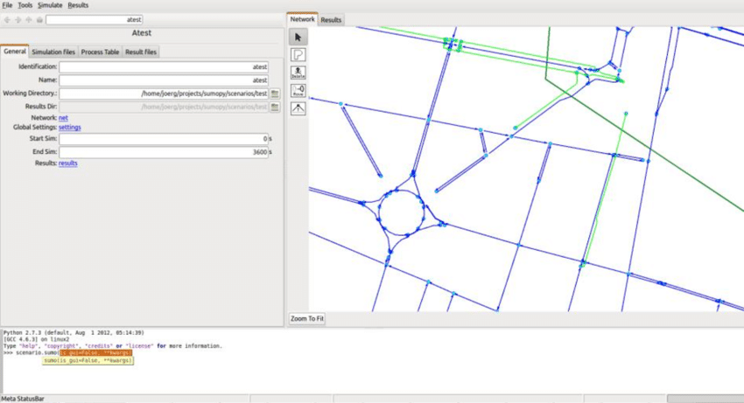
Challenges and Solutions
Original paper did not have good instructions to follow for demo
The paper was also not really in depth about any Markov decision process
Setting up the environment was difficult because there was no requirements.txt
Model results looked like something on the right but we had a lot of errors running the model and being able.
We also were using data that we had no idea what it meant because it was in a different language.
There was also no easy reference to replicate because the demo instructions were not clear and concise.

Slide 14
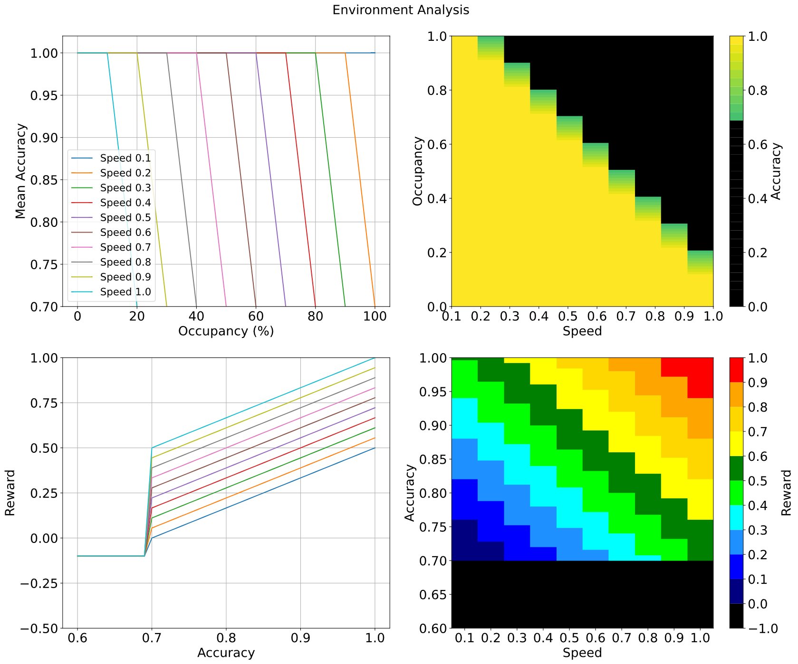
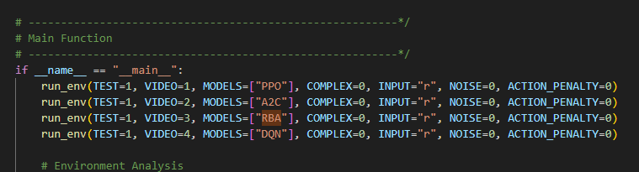
Challenges and Solutions
Our backup paper was a lot easier to understand
Code was a lot easier to work with and understand
All we had to do was create an environment and install all the requirements
Main.py has a variety of different variables to run different models and parameters.
We were able to run the model with 1000 iterations since 100k iterations took too long.`

Slide 15
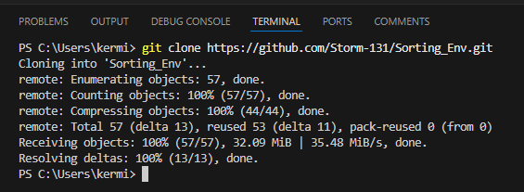
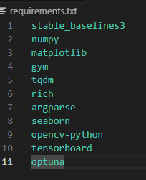
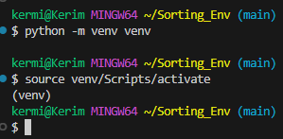
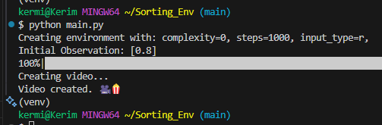
Code Base Setup
Setup for running code base
For the hardware setup of this project the main step we had to do was git clone the repository on our local machines.
Create an environment
Run Requirements.txt (image A) to get all required dependencies installed
Change parameters to how we want to experiment in main.py
Run main.py (Image B)
Image A
Image B

Slide 16

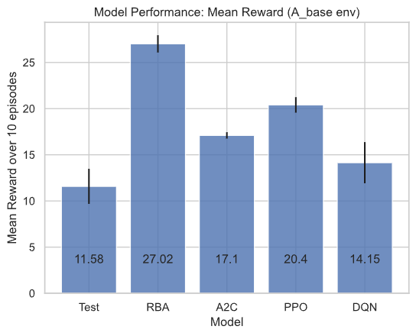
Code Base Setup
Successful setup and running code base.
The video displays the experiment of the PPO model running. We have different results from the paper because we used only 1k iterations rather then 100k.
Hardware: Can run on any machine since it uses a CPU instead of a GPU
The code is pretty complex so changing things in the main.py and other files might cause complications.

Slide 17

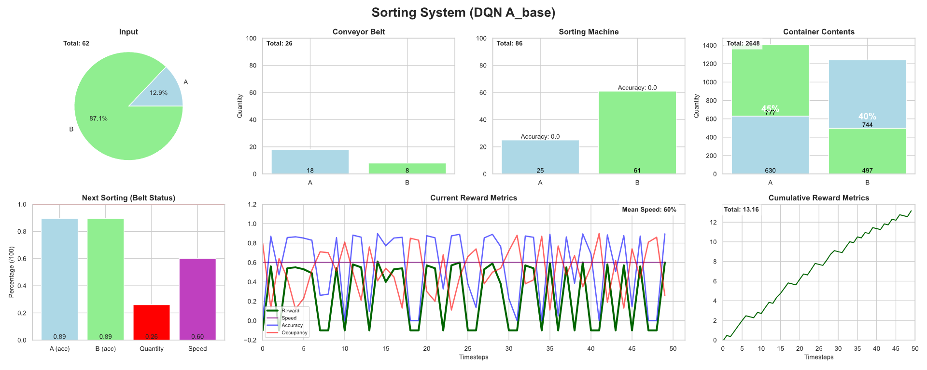
Plan for Completion
Experiments that we intend to repeat
Rerun the code with the same parameters to ensure we get the same results from the paper (image A) for both environments
Experiments we plan to not repeat would be
Redoing Basic Tests: The paper already compares PPO, A2C, DQN, and RBA, so we don’t need to repeat the same tests.
RBA can't be trained on time-dependent data, hence it calculates it's reward based on the current state of "Belt Accuracy" (not the accumulative Container-Purity)
Image A

Slide 18
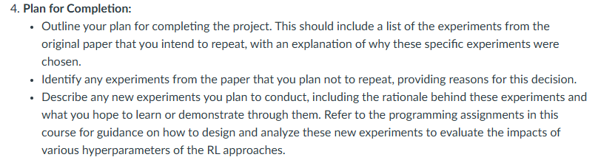
Plan for Completion
New experiments we plan to conduct
Models | Experiment | Rationale | What we expect to learn
PPO, A2C | Dynamically change action penalty based on performance | Action penalty currently applied based on input type, either 0 or 0.5 | Improve learning efficiency and policy stability
PPO, A2C | Gradually change noise levels | Analyze model stability with changing noise levels rather than using a uniform distribution | How different noise levels impact the models
PPO, A2C | Changing accuracy threshold | Testing 0.5 and 0.9 accuracy thresholds as it is hardcoded to 0.7 | How different accuracy thresholds impact the models

